Slide 1
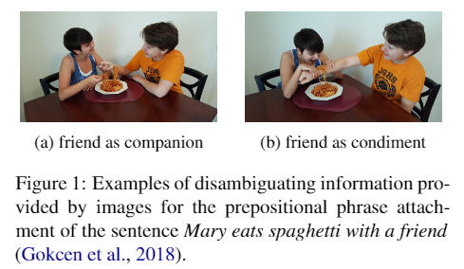

Slide 2
Visually Grounded Neural Syntax Acquisition
ACL2019 Haoyue Shi, Jiayuan Mao, Kevin Gimpel, Karen Livescu
What is Learned in Visually Grounded Neural Syntax Acquisition
ACL2020 Noriyuki Kojima, Hadar Averbuch-Elor, Alexander Rush and Yoav Artz
Compound Probabilistic Context-Free Grammars for Grammar Induction
ACL2019 Yoon Kim, Chris Dyer, Alexander M. Rush
Visually Grounded Compound PCFGs
EMNLP2020 Yangpeng Zhao, Ivan Titov
Video-aided Unsupervised Grammar Induction
NAACL2021 Songyang Zhang, Linfeng Song, Lifeng Jin, Kun Xu, Dong Yu, Jiebo Luo

Slide 3
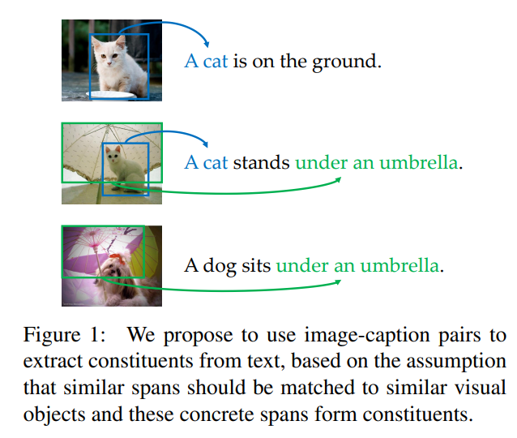
Visually Grounded Neural Syntax Acquisition
Intuition
“Given no prior knowledge of English, and sufficient such pairs, one can infer the correspondence between certain words and visual attributes.”
“One can further extract constituents, by assuming that concrete spans of words should be processed as a whole, and thus form the constituents.”
Using image-text pairs to facilitate automated language learning, including both syntax and semantics.

Slide 4
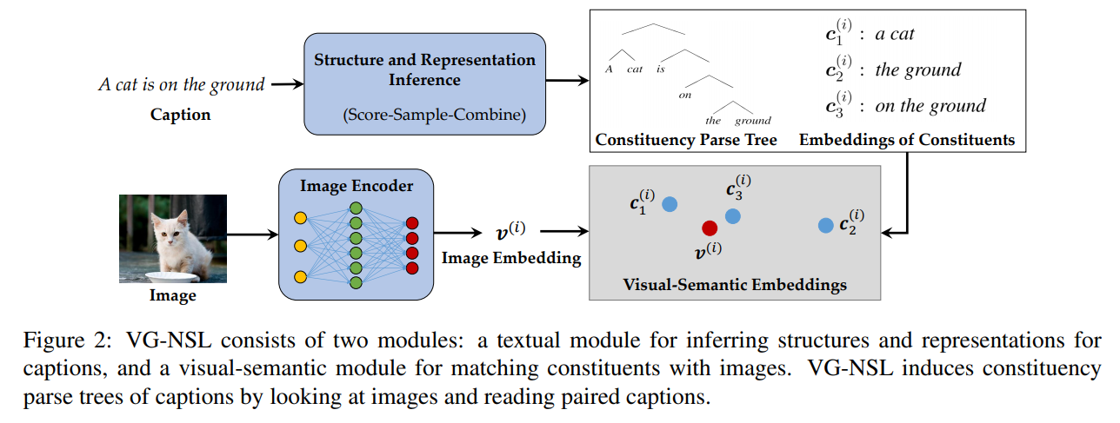
Method

Slide 5
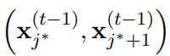
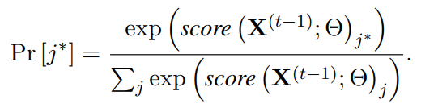
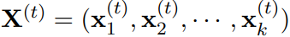
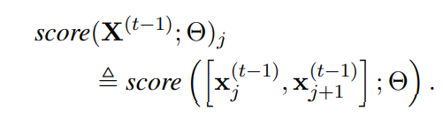
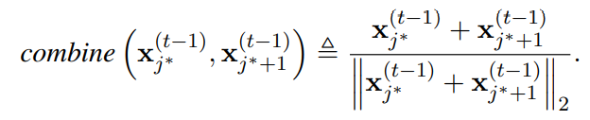
Parsing
Composing a binary constituency structure of text, using an easy-first bottom-up parser.
A pair of constituents is sampled from all pairs with
to form a new constituent represented as
For a caption of length n consists of n-1 steps
At t steps: the textual representations of a sequence of constituents is :
A score function score is evaluated on all
pairs of consecutive constituents

Slide 6
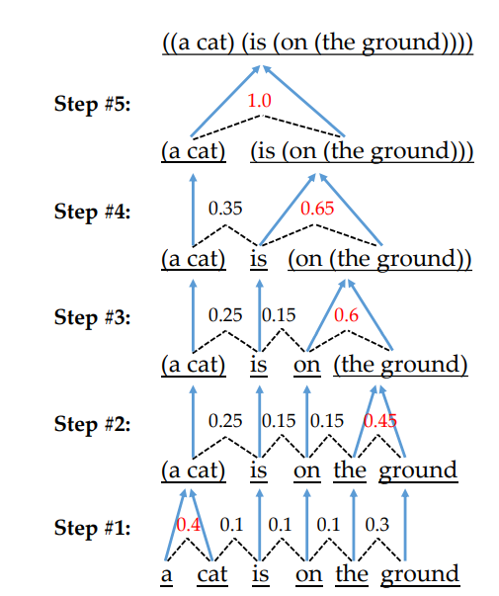
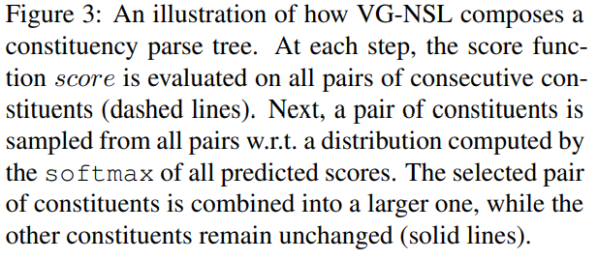
Parsing

Slide 7
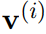
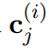
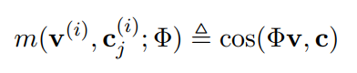
Visual-Semantic Embeddings
denote the vector representation of an image i
denote the vector representation of the j-th constituent of its corresponding text caption.
During the matching with images, we ignore the tree structure and index them as a list of constituents.
A function m

Slide 8
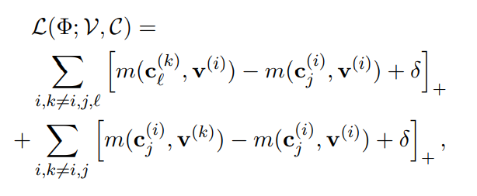
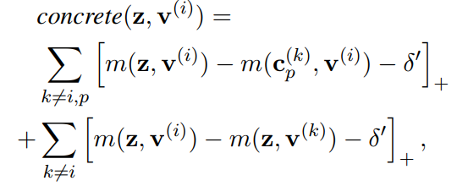
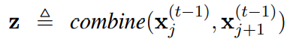
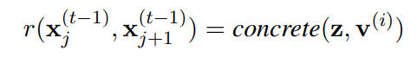
Training
To optimize the matching the visual and the textual representations.
To optimize textual structures (Reinforce, Distant supervision)
During training, we sample constituency parse trees of captions, and reinforce each composition step.

Slide 9
The Head-Initial Inductive Bias
English and many other Indo-European languages are usually head-initial :
During training, we encourage the model to associate these abstract words(on, which, where) with the succeeding constituents instead of the preceding ones.

Slide 10
Data Sets and Metrics
Picture & Text: MSCOCO. 82,783 images for training, 1,000 for development, and another 1,000 for testing. Each image is associated with 5 captions
Golden Tree: Apply Benepar[1] with state-of-the-art performance (95.52 F1 score) on Wall Street Journal test set.
[1].Nikita Kitaev and Dan Klein. ACL2018. Constituency parsing with a self-attentive encoder.

Slide 11
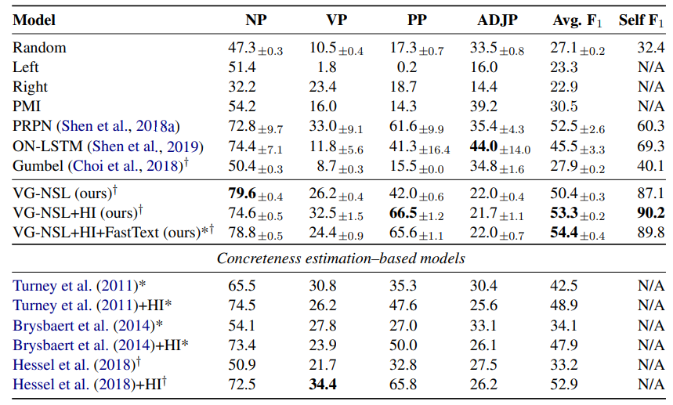
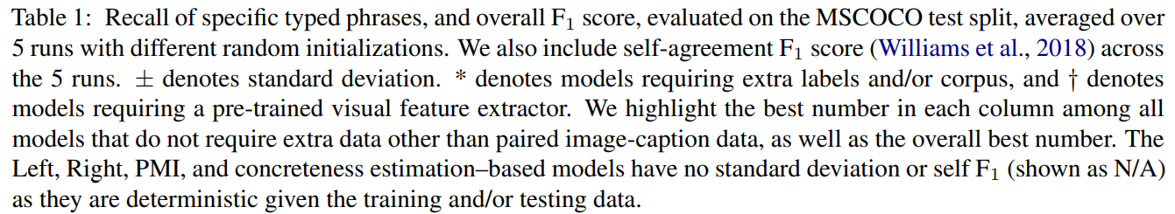
Result

Slide 12
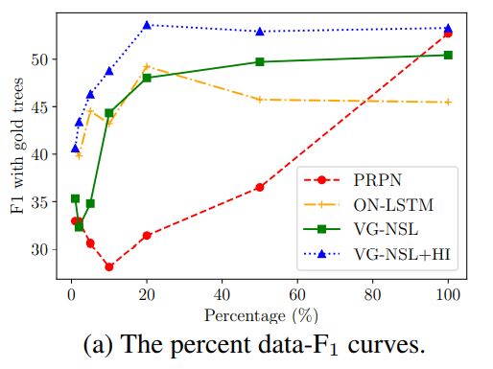
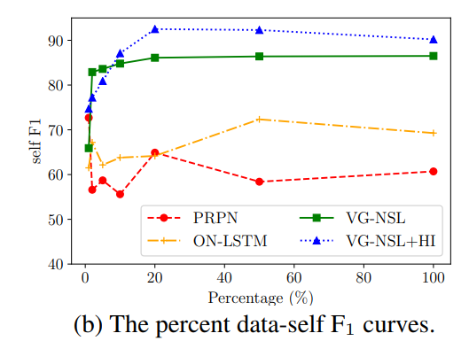
Results: Data Efficiency

Slide 13
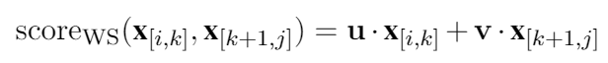
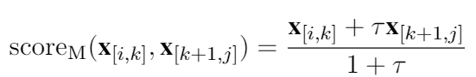
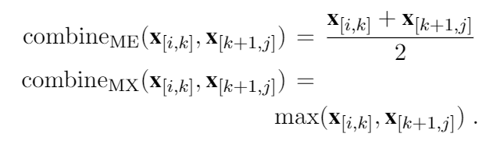
What is Learned in Visually Grounded Neural Syntax Acquisition ACL2020 Noriyuki Kojima, Hadar Averbuch-Elor, Alexander Rush and Yoav Artz
Keeping the same inference algorithm and learning procedure. Constraining model expressivity
1.Embedding Bottleneck ：Embedding from 512 to 1 by a MLP.
2.Simiplified Scoring：
3.Reduced Dimension Combine

Slide 14
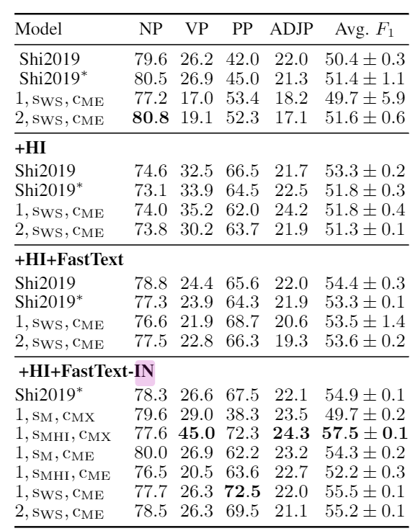

Slide 15
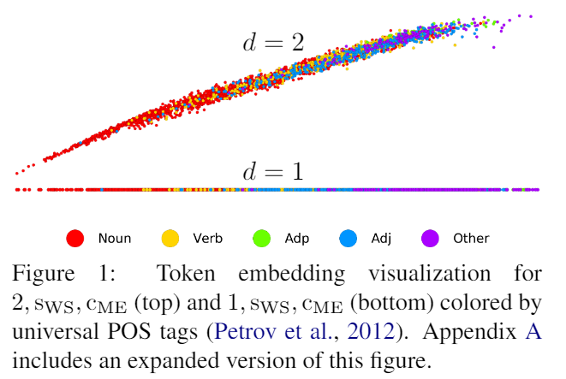
The token embedding

Slide 16
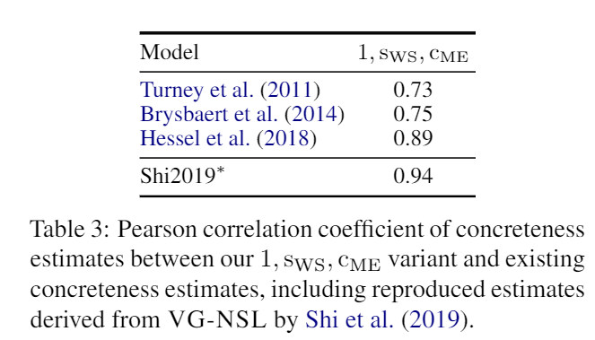
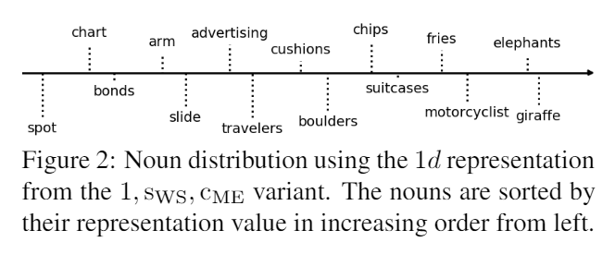
Is the concreteness

Slide 17
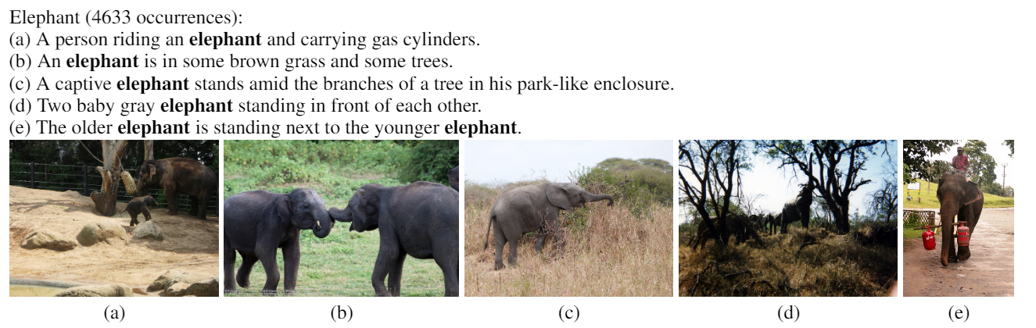
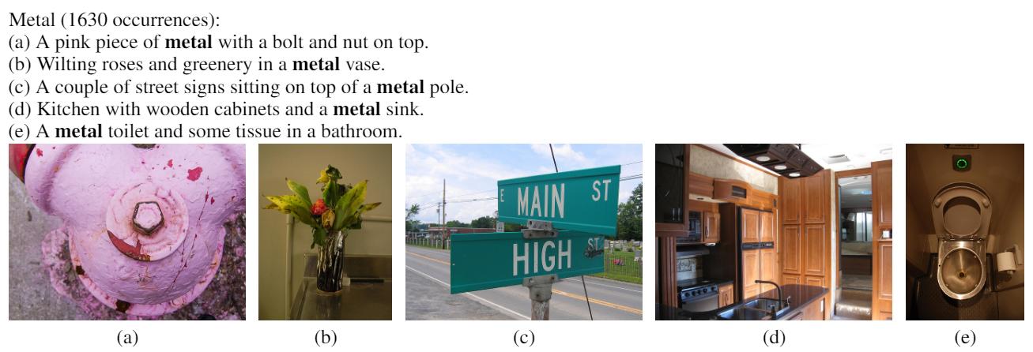

Slide 18
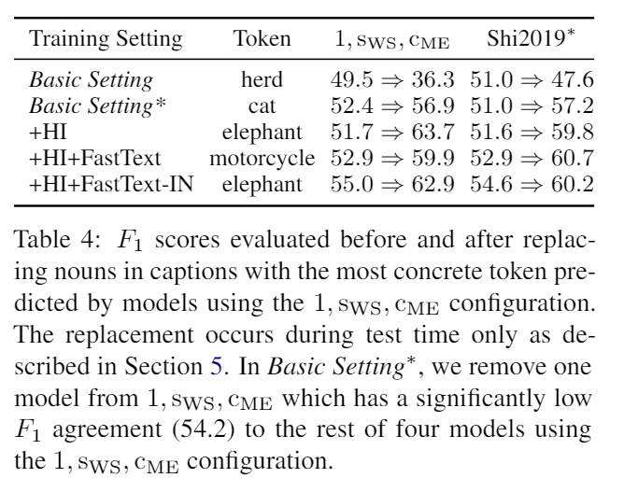
In test: Change Abstract to Concreteness
For example, instead of parsing the original caption "girl holding a picture," we parse "elephant holding an elephant."
Chris Dyer, Gábor Melis, and Phil Blunsom. 2019. A critical analysis of biased parsers in unsupervised parsing.arXiv preprint arXiv:1909.09428.

Slide 19
Grounded PCFG Induction with Images AACL2019 Lifeng Jin and William Schuler

Slide 20
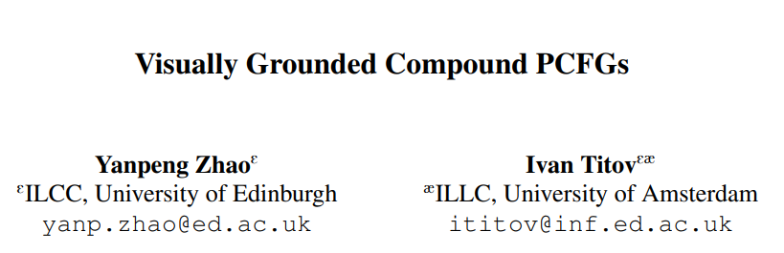

Slide 21
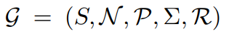
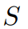
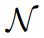
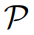

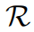
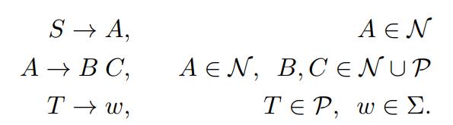
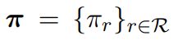
P-CFG:
Compound Probabilistic Context-Free Grammars for Grammar Induction
CFG: 5-tuple
Start symbol
a finite set of nonterminals
a finite set of preterminals
a finite set of terminal symbols
a finite set of rules
P:

Slide 22
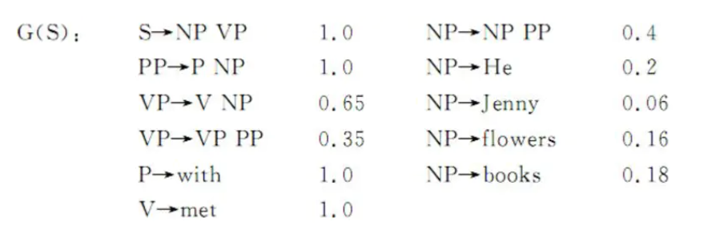
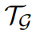
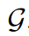
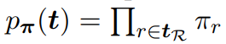
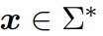
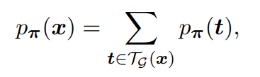
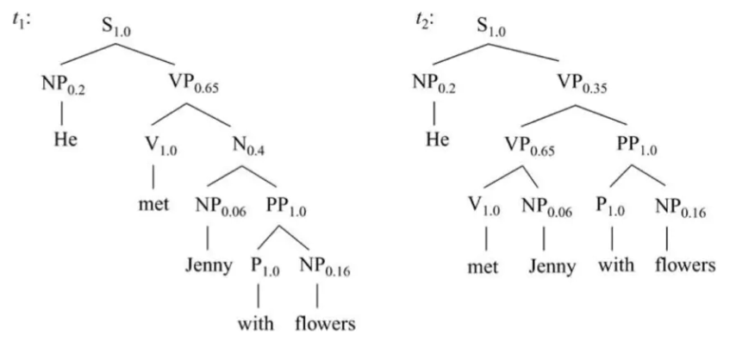
PCFG: An example
be the set of all parse trees of
Probability of Tree:
string of terminals
He met Jenny with flowers

Slide 23
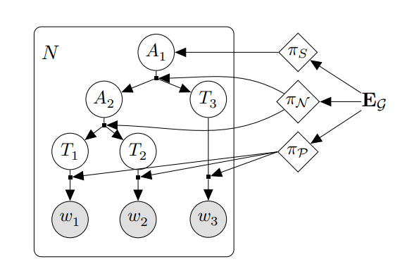
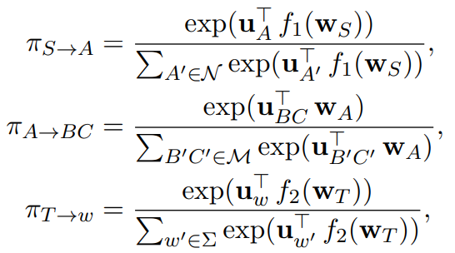
Parameterization
For each rule type
The set of input symbol embeddings for a grammar

Slide 24
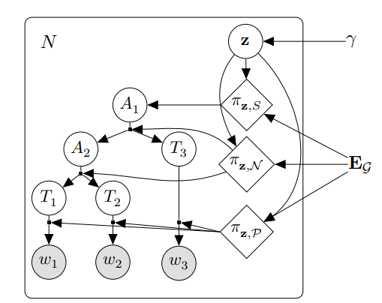
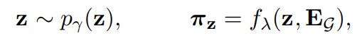


Compound PCFG
the input symbol embeddings with and outputs the sentence-level
rule probabilities

Slide 25


Inference
Maximize
In C-PCFG
For Integral over z

Slide 26




End-to-End contrastive learning

Slide 27




Span representation
Using inside time and memory inefficient.
A mean-pooling layer is applied over the hidden states h of the BiLSTM and followed by a label-specific affine transformation
to produce a label-specific span representation

Slide 28


Joint objective

Slide 29

Result

Slide 30


Result

Slide 31

Video-aided Unsupervised Grammar Induction

Slide 32


Span Representation
Extracting video representation from M models
M expert: Object features, Action features, Scene features, Audio features, Scene features, Audio features, OCR features, Face features, Speech features
Multi-head self-attention module and a feed forward network

Slide 33



Video-Text Matching
the set of expert embeddings as and the video-span similarity

Slide 34



Loss

Slide 35
Dataset
DiDeMo： 10K unedited, personal videos from Flickr with roughly 3 − 5 pairs of descriptions and distinct moments per video. There are 32 994, 4 180 and 4 021 video sentence pairs, validation and testing split.
YouCook2： 2K long untrimmed videos from 89 cooking recipes. On average, each video has 6 procedure steps described by imperative sentences. There are 8 713, 969 and 3 310 video-sentence pairs in the training, validation and testing sets.
MSRVTT：contains 10K videos sourced from YouTube which are accompanied by 200K descriptive captions. There are 130 260, 9 940 and 59 794 video-sentence pairs in the training, validation and testing sets.

Slide 36

Result

Slide 37

Constituent Length

Slide 38

Constituent Length

Slide 39

Contribution of different modalities.

